Slide 1
Notes:
This the slide template download from Siggraph Website ： http://s2016.siggraph.org/content/electronic-slides-and-still-images

Slide 2
Image Perforation: Automatically Accelerating Image Pipelines by Intelligently Skipping Samples Liming Lou^{1,3} Paul Nguyen¹
Jason Lawrence^{1,2} Connelly Barnes¹
Presenter: Liming Lou^{1,3} ¹University of Virginia ²Google ³Shandong University
Notes:
Good morning, everyone~ Thank you for comming~ In this talk, I will present IMAGE PERFORATION which is designed to BALANCE the performance-accuracy trade-offs within an image pipeline.

Slide 3
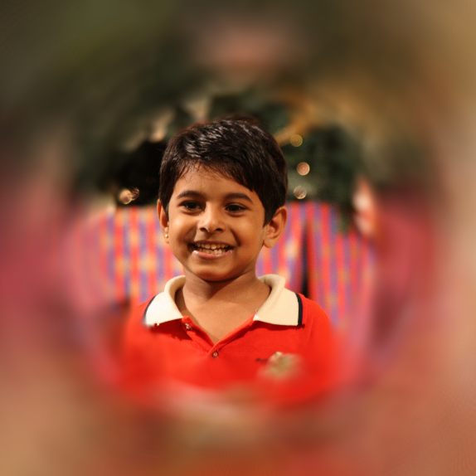
Image Pipeline Example: Artistic Blur
Notes:
Modern image pipelines are used to produce a wide range of artistic effects, such as this one.

Slide 4
Image Pipeline Example: Artistic Blur
SLOW!
Notes:
BUT they can be computationally intensive and slow.

Slide 5
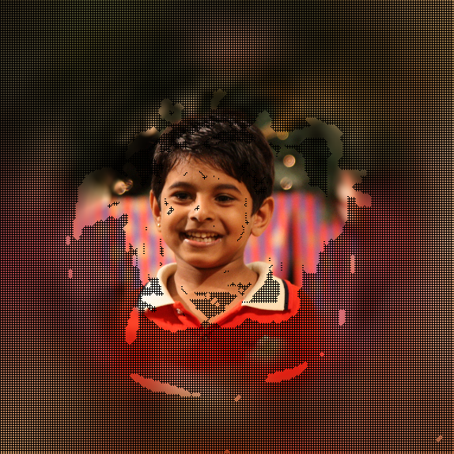
Image Pipeline Example: Artistic Blur
Notes:
One way to speed up image pipelines is to compute only a fraction of the output pixels. HOWEVER the output image will have unacceptable error.
So it is not enough to only skip pixels, we also need some way of reconstructing the pixels that are skipped.

Slide 6
Image Pipeline Example: Artistic Blur
6x speedup / 0.28 Lab L2 error
Notes:
On the right is the result of our method that performs this type of perforation and reconstruction. In this case it ACHIEVES a speed up of 6x for only a small amount of approximation error.

Slide 7
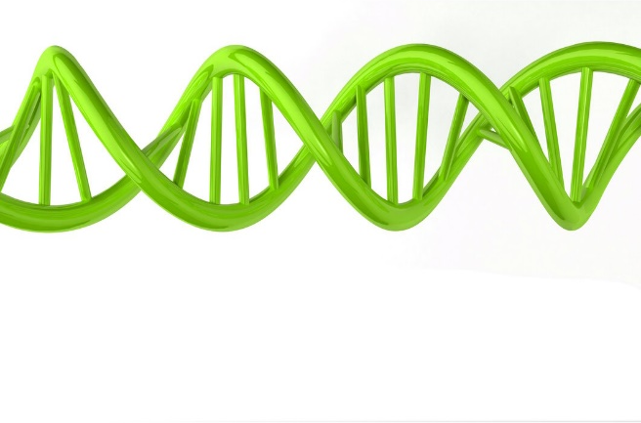
System Overview
Perforation Strategies
Reconstruction
Strategies
Error
<\>
<\>
<\>
<\>
<\>
Genetic search
<\>
<\>
Speed
Image Pipeline
Notes:
Let me show u a diagram for better understanding our method. In order to speed up AN arbitrary image pipeline, we first skip samples. We call this “perforation.” However We then NEED to RECONSTRUCT those missing samples based on the others nearby. In each case there are a couple different strategies. We develop a compiler and optimizer so these techniques are fully automatic and can be applied to any image pipeline. [click] The compiler takes an arbitrary image pipeline as input, [click] runs a genetic search OVER the strategies for SKIPPing and RECONSTRUCTing pixels, and THEN outputs [click] a number of different program variants which trade off speed and accuracy for the input image pipeline.

Slide 8
Prior Work: Loop Perforation [Sigioglou-Douskos et al. 2011]
for (int i=0; i<N; i+=1) {
.
.
.
}
for (int i=0; i<N/2; i+=4) {
.
.
.
}
Notes:
Our work is related to loop perforation, a general strategy for reducing runtimes by skipping iterations in loops. HERE is a simple example that increases the step size and changes the bounds.

Slide 9
Prior Work: Loop Perforation [Sigioglou-Douskos et al. 2011]
Input Image
Output Image
Notes:
Although loop perforation reduces runtime, it CANNOT be directly applied to image pipelines, as this will result in many missing pixels.

Slide 10
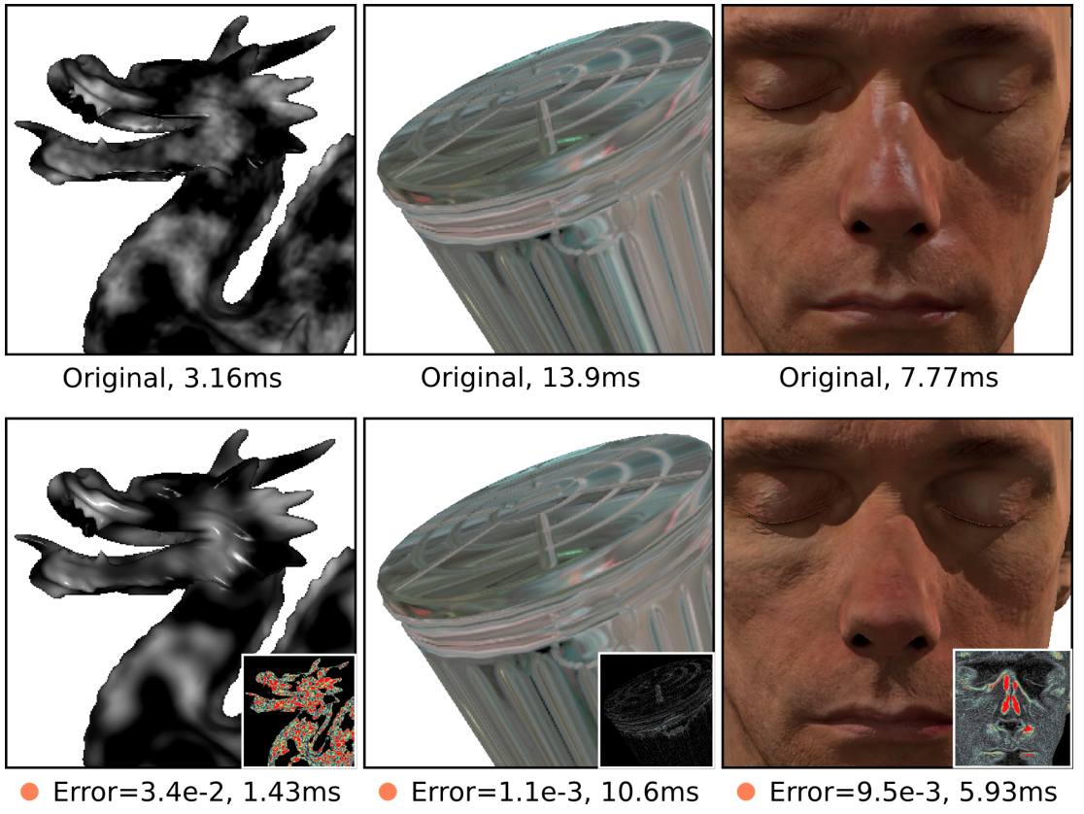
Prior Work: Shader Simplification [Sitthi-Amorn et al. 2011]
Notes:
Genetic algorithms use an evolutionary algorithm to search for a set of programs that optimize some fitness criterion. Recent work by Sitthi-Amorn et al.[2011] describes a Genetic Programming approach to the problem of automatic procedural shader simplification. Although our method is inspired by this prior work, we employ a straightforward genetic algorithm and focus on the problem domain of image processing.

Slide 11
System Overview
Perforation Strategies
Reconstruction
Strategies
Error
<\>
<\>
<\>
<\>
<\>
Genetic search
<\>
<\>
Speed
Image Pipeline
Notes:
Now I will next talk about the first part of our system…

Slide 12
System Overview
Perforation Strategies
Reconstruction
Strategies
Error
<\>
<\>
<\>
<\>
<\>
Genetic search
<\>
<\>
Speed
Image Pipeline
Notes:
“Perforation.” Our system uses three different perforation strategies: Grid sampling, Adaptive Sampling and Importance Sampling.

Slide 13
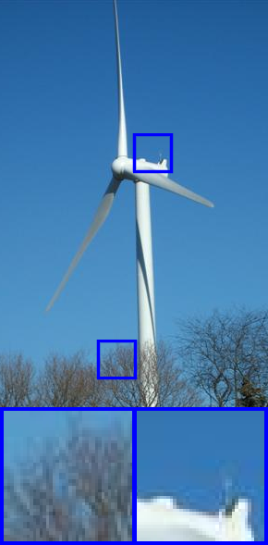
Perforation Strategies: Grid Sampling
Input Image
Grid Samples
Notes:
Grid sampling transforms a loop which corresponds to a given stage in an image pipeline, so that only certain pixels within the loop are computed.
The white pixels indicate the samples that are actually computed. The black pixels indicate where we skip the computation. We show zoom regions below each image.

Slide 14
Perforation Strategies: Adaptive Sampling
Input Image
Adaptive Samples
Notes:
Our second perforation method is adaptive sampling. It starts with the coarse grid samples that are taken from grid sampling. [click] And then it adds additional fine-spaced samples to the grid in areas where the result image from the given stage of the image pipeline has high intensity variation. The fine sample regions are white squares within which all pixels are computed.

Slide 15
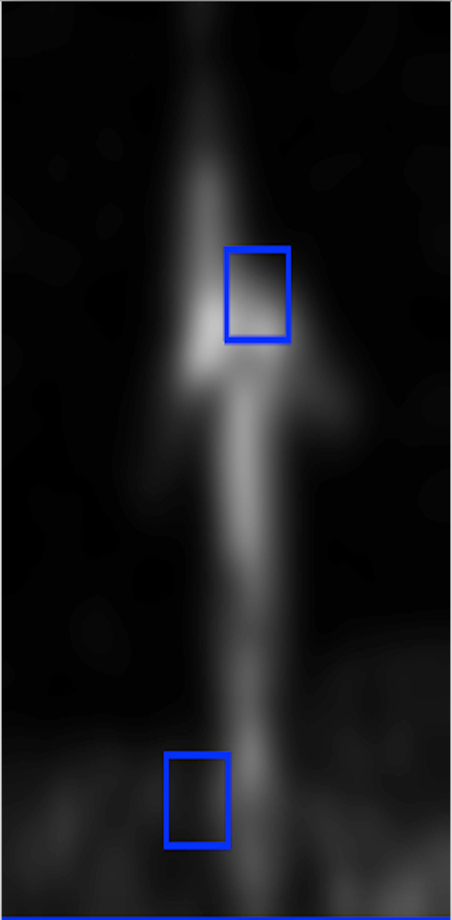
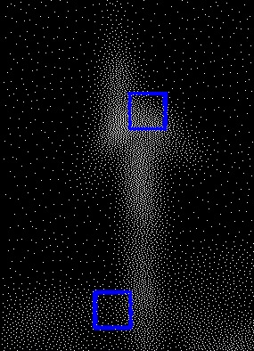
Perforation Strategies: Importance Sampling
Input Image
Importance Map
(Bae et al. [2006])
Importance Samples
Notes:
Our third and final perforation strategy is importance sampling. Unlike adaptive sampling, which has sample locations that change for every stage of the pipeline, importance sampling computes sample locations that are fixed for a given input image across all pipeline stages.
This strategy allows a multi-stage pipeline to potentially REUSE the same sample locations, and thus pay less overhead due to computing sample locations at each stage.

Slide 16
Perforation Strategies: Importance Sampling
Input Image
Importance Map
(Bae et al. [2006])
Importance Samples
Notes:
Samples are placed proportionally to a measure of texturedness that we call an ”importance map.” This is computed using a slight modification to the method of Bae et al. [2006]. We dither [Dith-ER] the importance map to obtain sample locations.

Slide 17
Reconstruction Strategies
Precomputed Reconstruction
Perforation
Strategies
Reconstruction
Strategies
On-demand
Reconstruction
Notes:
We explored several strategies to reconstruct missing samples. We used both pre-computed [click] and [click] on-demand reconstruction. Pre-computed reconstruction computes missing samples immediately after a given stage. In contrast, on-demand reconstruction does NOT compute missing samples immediately, but only computes them lazily when they are referenced in a later pipeline stage. I will now discuss a few methods for precomputed reconstruction.

Slide 18
Precomputed Reconstruction: Nearest Neighbor
For grid sampling, can simply use color from nearest known sample
For irregular samples, use distance transform [Rosenfeld et al. 1968]
Notes:
Nearest neighbor reconstruction simply copies the nearest color from a known sample. For grid sampling, we can simply look up the nearest known sample from the grid. For irregular sample patterns, we use the Manhattan distance transform to reconstruct the missing samples. For example, [click] suppose there are three known samples represented by the red, blue, and orange colors. The missing samples in black are filled in [click] by copying colors from the nearest known sample.

Slide 19
Pre-computed Reconstruction: Billinear
Can be used only for grid sampling
(x, y)
Notes:
The second reconstruction strategy in our system is bilinear reconstruction. This simply uses the four nearest samples to reconstruct missing samples. Note that this can only be used along with the grid sampling perforation strategy because the other perforation strategies are not guaranteed to produce missing samples contained within a square of four known samples.

Slide 20
Pre-computed Reconstruction: Spatially Invariant Gaussian
Interpolate known sample colors to fill in missing colors
Interpolation weights are a Gaussian function with fixed σ
Missing Sample
?
Known Samples
Notes:
The third type of reconstruction uses a weighted average to [click] interpolate the color at the missing sample from surrounding known samples. [click] Specifically, we apply fixed Gaussian weights to nearby samples to [click] interpolate the color at the missing sample.
These weights are computed in two passes in scanline order over the image using a filter that has an infinite impulse response and provides a good approximation of the ideal spatially invariant reconstruction kernel. Please see the paper for details.

Slide 21
Pre-computed Reconstruction: Spatially Varying Gaussian
Repeated integration [Heckbert 1986]
Interpolation weights $∝exp⁡\left(\frac{{−\left\|pi−\right.\left.pj\right\|}^{2}}{{2σ(x,y)}^{2}}\right)$
Gaussian standard deviation ($σ$):
For adaptive sampling: $σ\left(x,y\right)=\left\{\begin{aligned}σ0k \text{if} \text{coarse} \text{sample} \\ 0.0\text{1 }\text{if} \text{fine} \text{sample}\end{aligned}\right.$
For importance sampling: $σ\left(x,y\right)=σ0/{M(x,y) }^{1/2}$
Notes:
Finally, our system also supports spatially-varying Gaussian reconstruction using the method of repeated integration, in cases where the perforation strategy results in a non-uniform distribution of samples.
For adaptive sampling, we apply different standard deviations for coarse samples and fine samples. Here, k refers to the coarse sample spacing.
For importance sampling, the standard deviation is computed according to this formula where M refers to the importance map and sigma-naught (“sigma NOT”) is a parameter determined during the genetic search.

Slide 22
Reconstruction Strategies: On-demand Reconstruction
Precomputed Reconstruction
Perforation
Strategies
Reconstruction
Strategies
On-demand
Reconstruction
Notes:
The other type of reconstruction is on-demand. Instead of reconstructing missing samples in advance, we reconstruct samples only when they are needed by subsequent stages of an image pipeline.

Slide 23
On-demand Reconstruction
Optimizations used in on-demand reconstruction:
Rewriting pixel reads
Storage optimization
Congruence simplification
Notes:
We perform on-demand reconstruction only with grid sampling, because the fixed grid locations allow for fast reconstructions.
There are three different methods used in on-demand reconstruction: [click] rewriting pixel reads; [click] Storage optimization and [click] Congruence simplification. Due to limited time I will describe only the first two methods. See the paper for the third method.

Slide 24
On-demand Reconstruction: Rewriting Pixel Reads
Rewrite subsequent pixel read operations
With nearest neighbor reconstruction: lookup known sample from nearest grid point
?
Notes:
If any subsequent stage of the image pipeline attempts to read a missing sample we modify the read operation accordingly. For example, if [click] nearest neighbor reconstruction is being used then this read operation can [click] simply be rounded to the nearest integer which corresponds to a known sample and this can be done by modifying the array lookup expression.

Slide 25
On-demand Reconstruction: Storage Optimization
Pixel reads in later stages simply use the same reconstruction as before, but with coordinates appropriately divided by the spacing
I(x,y,…) becomes I(x/s₁,y/s₂,…)
Storage requirements are reduced
Notes:
To reduce storage requirements and improve cache performance, the storage optimization packs the known samples in more closely by dividing by the grid spacing.
You can regard this strategy as image downsampling.

Slide 26
Compiler that Searches for Good Schedules
Perforation
Strategies
Reconstruction
Strategies
Error
<\>
<\>
<\>
<\>
<\>
Genetic search
Sitthi-Amorn et al. [2011]
<\>
<\>
Input pipeline
Speed
Notes:
Now I want to discuss the prototype compiler we built. [click]It takes the source code for an arbitrary image pipeline as input and automatically optimizes it. The compiler uses [click] the genetic search algorithm of Sitthi-Amorn [Sith(sis)-yi-Am-ORN(orin)] et al. [2011] to identify good sampling and reconstruction strategies for EACH STAGE of the image pipeline. One program is the input for the compiler, and [click] many program variants are output. These program variants represent optimal trade-offs between the speed of the program and the error introduced by perforation stage.

Slide 27
Compiler that Searches for Good Schedules
Mutation
A: Grid sampling
B: Importance sampling
C: Adaptive sampling
…
Perforation strategies
Stage 1
Stage 2
Stage 3
Stage 4
...
D: Pre-computed
E: On-demand
…
Reconstruction strategies
Notes:
The compiler’s genetic search maintains a population of program variants, which optimally trade off error and speed. To create the next generation of program variants, two rules are used in the genetic search: mutation and crossover. The mutation rule selects for a given stage of the pipeline, and there is a random choice among all the options for [click] perforation and [click]reconstruction

Slide 28
Compiler that Searches for Good Schedules
Error
A₁A₂B₃A₄
A₁A₂A₃A₄
A₁B₂B₃A₄
Parent 1
A₁A₂B₃B₄
B₁B₂A₃A₄
Two point crossover
A₁B₂B₃B₄
B₁B₂B₃B₄
A₁B₂A₃A₄
Parent 2
Speed
Notes:
The compiler uses two-point crossover to generate a single child from two randomly chosen parent program variants. [click] The genetic search runs for multiple generations. It retains only the program variants that provide the best performance-accuracy trade-offs.

Slide 29
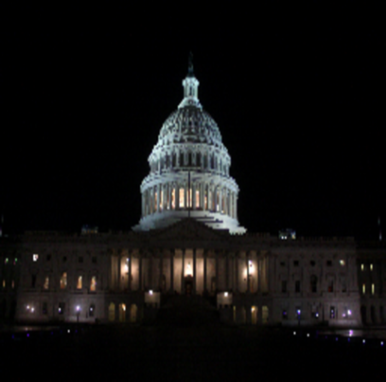
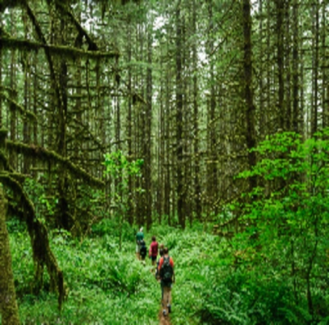
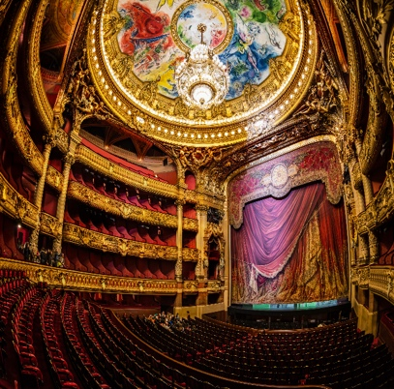
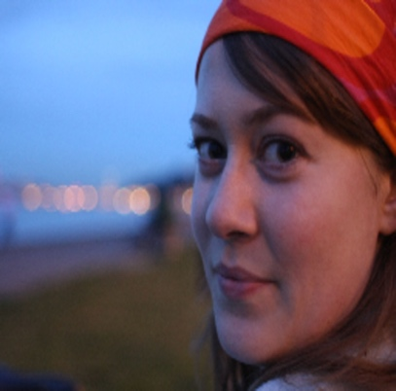
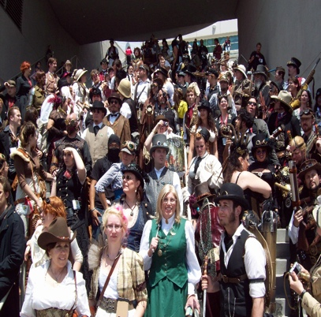
Image Dataset
Consists of 120 images
Divided into three categories: manmade, natural, and people
Used 6 images for training and 114 for testing
Notes:
To test our image pipelines, we constructed an image benchmark consisting of 120 images which is divided into three categories: man-made, natural, and people images. [click] 6 images are used as the training set, which the genetic search runs on. The remaining images are used to determine testing error.

Slide 30
Results
 | Artistic blur | Bilateral filter | Bilateral grid | 2-Pass Blur | Demosaic | Median | Unsharp Mask
Input Image
Reference
Notes:
We test 7 applications shown in this table. They are Artistic blur, bilateral filter, Bilateral grid, Blur, Demosaic, a median filter, and Unsharp Mask. We will go into details for only four applications due to limited time.
On the top row, we show an example input image. On the bottom row, we show the CORRECT ground truth output of the pipeline prior to applying any optimizations. We call this the reference output.

Slide 31
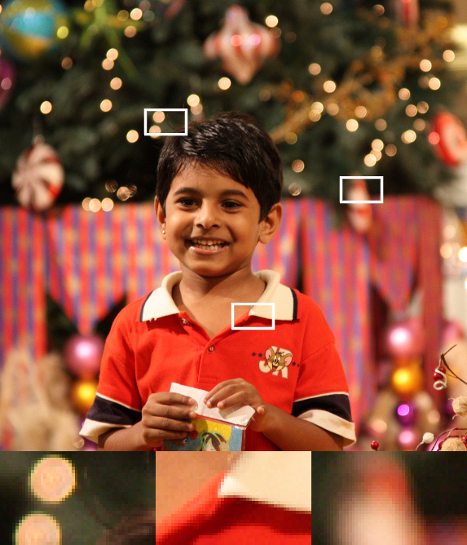
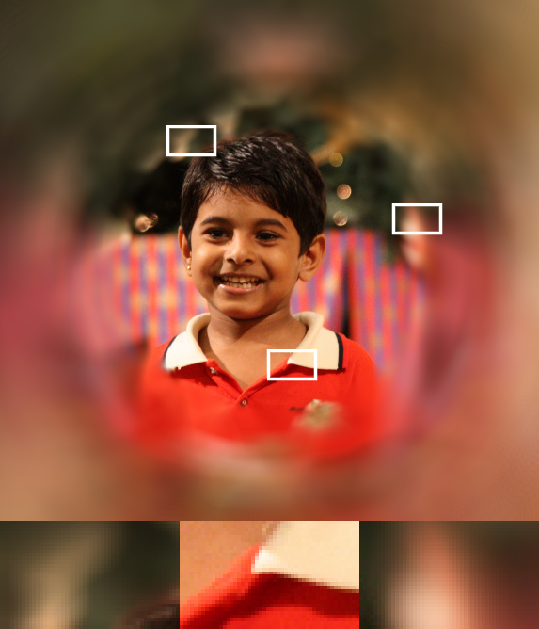
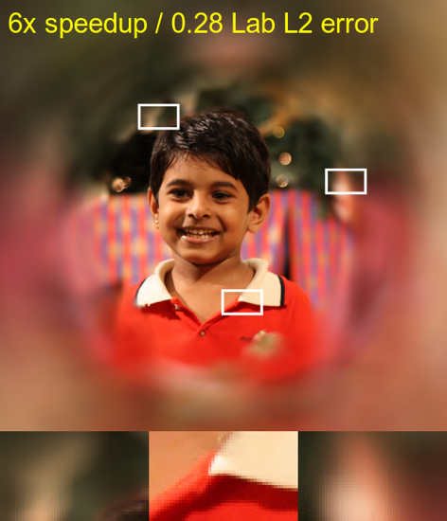
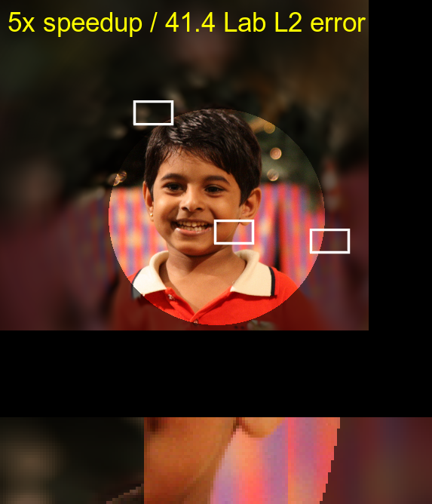
Result: Artistic Blur
Input Image
Reference Output
Image Perforation
Loop Perforation
Notes:
Here we show a comparison between our results and loop perforation at a given speedup of 6x for Artistic Blur which is mentioned before. LOOP PERFORATION simply leaves many pixels black whereas Our Approach reconstructs the missing pixels. Three zoom regions are shown below each image, with the zoom locations indicated by the white rectangles.
In this case, our method uses adaptive sampling and spatially varying Gaussian interpolation to reconstruct missing samples, whereas Loop Perforation leaves black regions due to skipping pixels.

Slide 32
Result: Artistic Blur
Input Image
Reference Output
Our Full Method
Ours Grid Only
Notes:
We also explore the importance of our non-grid sampling strategies. This shows a comparison between our full method and grid only sampling method. As is shown in the image, our full method reproduces high-frequency details in the center of the output image.

Slide 33
Result: Median Filter
Input Image
Reference Output
Image Perforation
Loop Perforation
Notes:
Here is another comparison for a standard median filter. Again, image perforation outperforms loop perforation across a range of acceptable errors and speedups. 3x is shown here. The loop perforation result contains strong aliasing artifacts due to the estimated median oscillating between modes when the gathered colors have a multimodal distribution. In this case, image perforation uses adaptive sampling and computes only 28% of the pixels, and then uses spatially varying Gaussian interpolation to reconstruct the skipped samples.

Slide 34
Result: Unsharp Mask
Input Image
Reference Output
Image Perforation
Loop Perforation
Notes:
This unsharp mask filter enhances high-frequency image details by taking a weighted sum of the input image and a blurred copy of the input image.
OUR image perforation result uses grid sampling for both stages of the blur, for a 3x speedup. In contrast, the LOOP PERFORATION result samples the last 42% of the first blur stage and last 34% of the second blur stage. Note that the LOOP PERFORATION introduces black regions in the blur, which after unsharp masking stage become overly bright regions of the output image.

Slide 35
Result: Demosaic
Input Image
Reference Output
Image Perforation
Loop Perforation
Notes:
This demosaic image pipeline is particularly challenging for our method, and illustrates one of our limitations. Since this demosaic filter is very simple and fast. so OUR METHOD is forced to use only grid sampling, because it does not incur any overhead for determining sample locations. Here we show a 2x speedup. Our method thus attenuates some high-frequency details and introduces chromatic aberrations due to using different sampling rates for different color channels. In contrast, LOOP PERFORATION leaves black regions due to skipping samples.

Slide 36
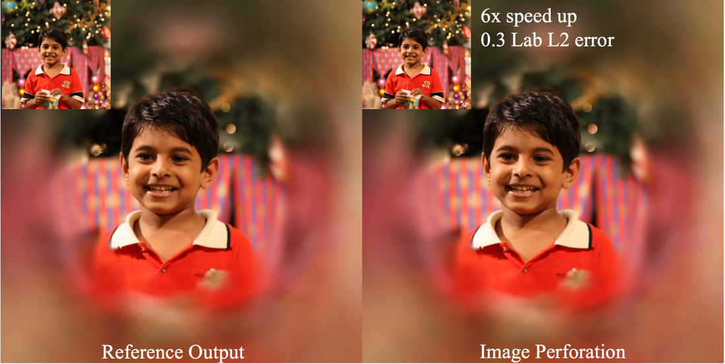
Limitations and Future Work
Challenge: vectorize the sampling patterns
Improve speed of adaptive sampling so it can be chosen even for pipelines that are already highly efficient
Support for streaming or GPU implementations
Notes:
In summary, image perforation is an automated technique for optimizing image pipelines. It transforms loops so that they skip certain samples and then reconstructs the missing colors. In all of the cases we studied, image perforation outperforms loop perforation, often by orders of magnitude.
However, challenges are also present, such as how one might best vectorize the regular sampling patterns produced by grid sampling. It might also be beneficial [click] to develop reconstruction that is tailored to be efficient for our adaptive sampling pattern, so that adaptive sampling can be chosen even for pipelines that are already highly efficient.
Extending image perforation to work with [click] the GPU would another way to achieve high performance.

Slide 37
Thanks!
ShanShan He for porting blur program to Halide. For supporting Liming Lou, we thank Prof. Meng Xiangxu.
This research was supported by NSF grants CCF 0811493, CCF 0747220 and the Chinese Scholarship Council.
Thanks to the photographers below who licensed their images under Creative Commons licenses: Cheon Fong Liew, Charles Roffey, Trey Ratcliff, Neal Fowler, Eric Wehmeyer, Duncan Harris, Sandy Glass, Gage Skidmore; Loren Kerns; ChrononautClub; Paulo Valdivieso; jhenryrose; Frank Swift.
Notes:
For supporting our project, we thank the researchers, funding agencies, and photographers shown on this slide.
Now, me and Connelly would be happy to answer any questions.

Slide 38
Code and Data
http://tinyurl.com/h5n3o74

